Slide 1
Security
AC22005

Slide 2
Summary of Topic
Introduction
Security threats
Design Principles for Security Measures
Types of Protection
  User-oriented control of access
  Data-oriented control of access

Slide 3
Security
Security is the collective name given to the tools, resources and administrative procedures that are designed to protect computing data and services.
Security has become the biggest collective headache of information systems.

Slide 4
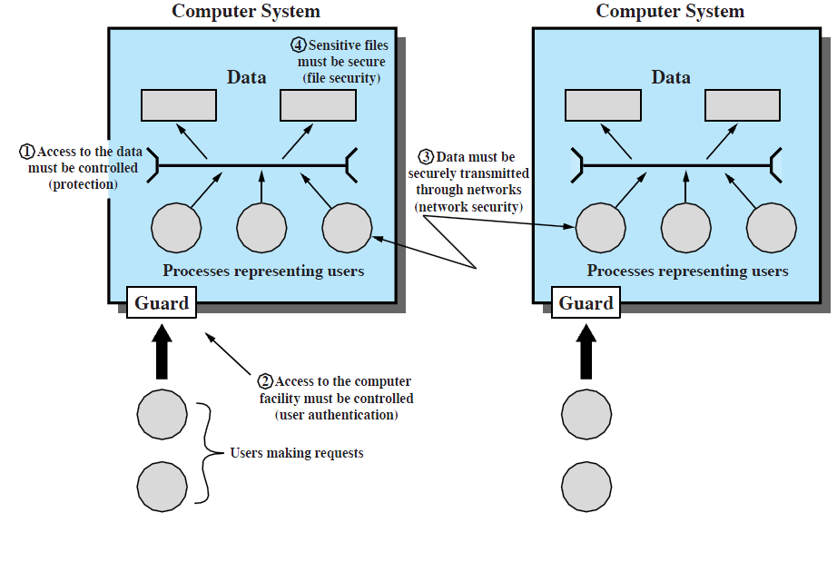
Scope of System Security
Ref: Stallings “Operating Systems”, Ed. 6, Fig. 14.2

Slide 5
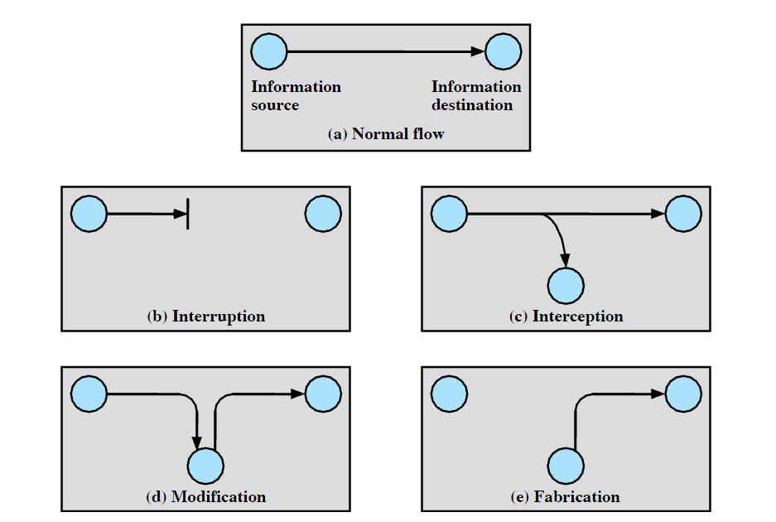
Security Threats
Ref: Stallings “Operating Systems” Ed.5, Fig. 16.2

Slide 6
Generic Types of Security Threat - 1
Interruption
  system asset becomes unavailable
  e.g. cutting of connection
Interception
  unauthorized access to system asset
  e.g. a hacker copying files

Slide 7
Generic Types of Security Threat - 2
Modification
  unauthorized modification to a system asset
  e.g. virus changing a program or destroying data
Fabrication
  unauthorized faking of an object in the system
  e.g. adding records to a file

Slide 8
Viruses - an example of the Modification threat
A virus is a small program that can attach itself to an existing program
Key feature - when the infected program is run, the virus code is also run (usually at the beginning or the end)
  when the virus code is run, it can look around for other programs to attach a replica of itself to
  if virus code runs fast enough, user won’t notice anything is unusual - the original program will appear to run as normal

Slide 9
Viruses
Some viruses are easy to detect, since the host program increases in size due to the addition of the virus code
Stealth viruses attempt to cover themselves up to avoid detection.
For example, one standard trick is to compress the original program so that the infected program (including virus) is still the same size.
This is shown on next slide...

Slide 10
Virus that uses compression
Virus compresses the
host program, then
attaches itself
Virus
code
Host
Program
Compressed
Host
Program

Slide 11
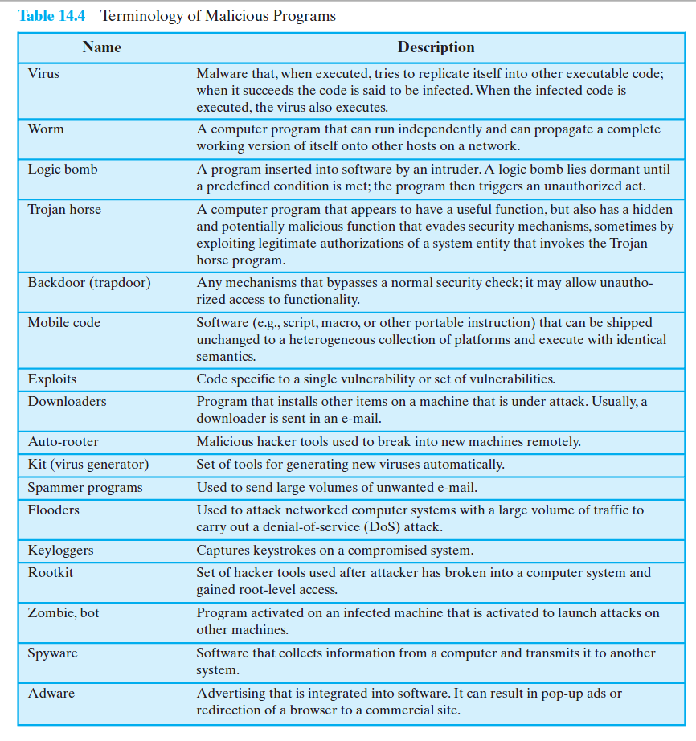
Ref: Stallings “Operating Systems”, Ed.6,
Figure 14.4

Slide 12
Brief Diversion: Question on Hard Disks
A platter shown
from above.
Each concentric circle is called a track. If indexed
allocation is being used where on the disk would a
good place to store the index blocks and FAT?

Slide 13
Answer to Disk Question.
A good place for index blocks and FAT and Disk Allocation Table would be in the middle tracks of the disk
  The disk arm would never be too far away from these

Slide 14
Design Principles for Security Measures
Least Privilege
Small, uniform security
Acceptability of the security measures
Complete Mediation
Open Design

Slide 15
Least Privilege / Small Uniform Security
Least Privilege
  processes operate using the smallest no. of privileges possible
  default is “no access allowed”
  privileges gained by explicit permission
Small, uniform security
  small and uniform implies easy to verify their correctness
  part of design, rather than ad-hoc

Slide 16
Acceptability / Complete Mediation
Acceptability of security measures taken
  shouldn’t get in the way of the user’s work
  if security mechanisms are difficult to use, they might be ignored or wrongly followed
Complete Mediation
  every access checked against access rights
  including those during maintenance

Slide 17
Open Design
The effectiveness of the security mechanisms should not depend upon secrecy of the design of the mechanisms themselves
  people will eventually discover the mechanism anyway
  mechanisms can be reviewed by several experts if they are not secret (desirable)

Slide 18
Types of Protection
User-oriented control of access
Data-oriented control of access

Slide 19
User-Oriented Access Control
The most common method is “the login”
Disadvantages:
  Forgotten passwords
  Open to attack hacking, since many people choose passwords that are easily guessed
Other control methods include
  keys, swipe card, bank card
  Biometrics, e.g. Retinal Scan

Slide 20
Data-Oriented Access Control
Define an Object to be anything to which access is being controlled
  e.g., files, programs
  e.g., portions of files, segments from segmentation
With data-oriented access control we are trying to control which processes can do which operations to which files and programs

Slide 21
Example – Microsoft Windows
Each process has an Access Token.
Each object has a Security Descriptor.
When a process tries to perform an operation on an object (file or program etc.), Windows uses the process’s Access Token to check the Security Descriptor to ensure that this operation is allowed.

Slide 22
Access Token - Windows
Each process’s Access Token stores the following
  Security ID (SID) - a unique number which identifies the user uniquely across all machines on network.
  Group SIDs - a list of the groups to which the user belongs. (Access can be defined on the basis of group and individual SIDs.)
  Information on privileges, owner.

Slide 23
Security Descriptor - Windows
Each object’s (e.g. file or program) Security Descriptor contains:
  Owner (the SID or Group SID of the owner of this object).
  Flags indicating what is all present in the Security Descriptor, e.g. DACL, SACL
  Discretionary Access Control List (DACL)
  System Access Control List (SACL)

Slide 24
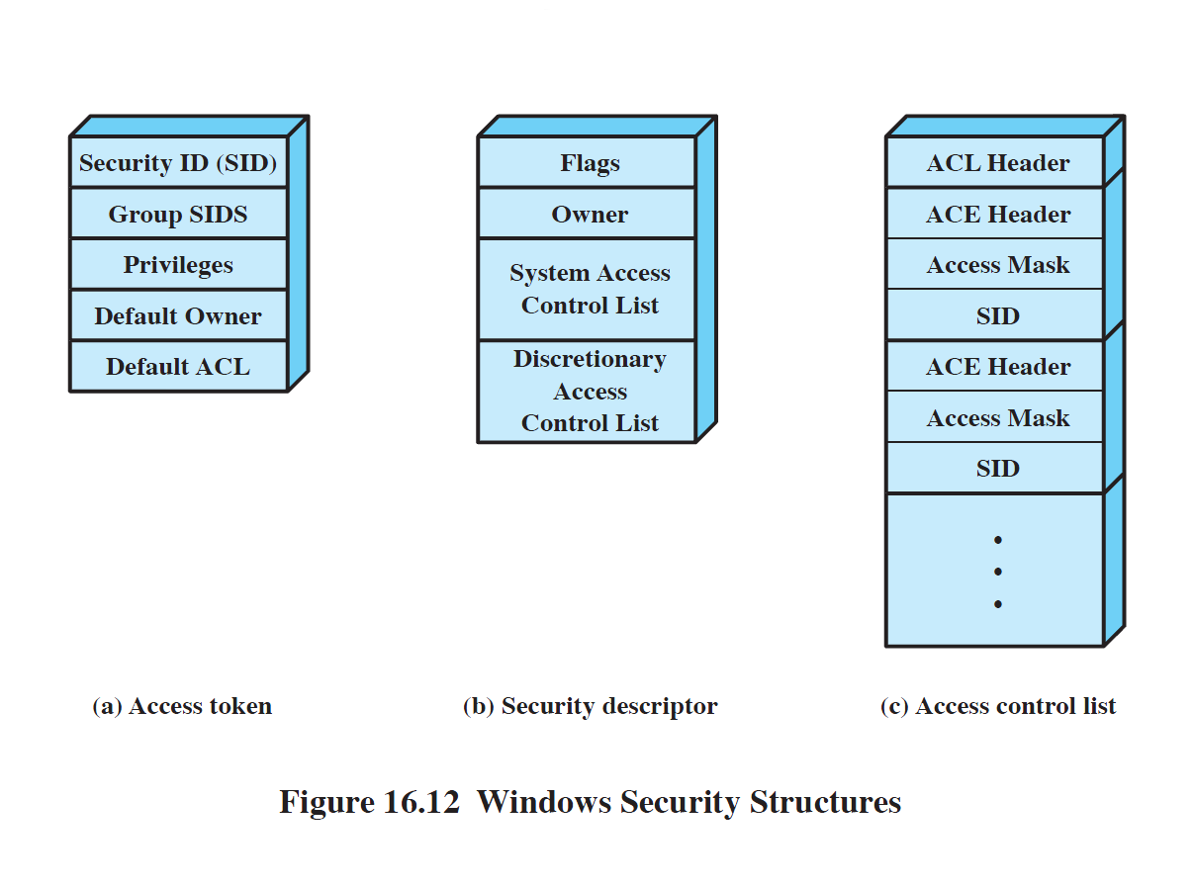
W.Stallings, “Operating Systems”, Ed. 6, Figure 16.12.

Slide 25
DACL and SACL
DACL determines which users and groups can access the object.
SACL specifies what kinds of operations on the object should generate audit messages.

Slide 26
Discretionary Access Control Lists
Each Discretionary Access Control List is a list in the following form:
  A header
  SID or Group SID plus an Access Mask
  SID or Group SID plus an Access Mask
  : : :
  : etc. :
The Access Mask states the way in which that SID can operate on this object (e.g. read only)

Slide 27
How are these used ?
When a process tries to perform an operation on an object (file or program etc.), Windows does the following:
  gets this process’s SID and group SID from its Access Token
  looks down the Discretionary Access Control List in the object’s Security Descriptor to try to find a matching SID in the list
  when found, the Access Mask is consulted to see if the requested operation is permitted.

Slide 28
Firewalls & Malware
Barriers between you and the Internet
It’s a grizzly world out there

Slide 29
Basic PC Security
You must have firewall and malware protection for your system.
Some of this may be provided by your local network (e.g. a firewall protecting your LAN or company network).
Some will have to be done on your workstation (e.g. software firewall).

Slide 30
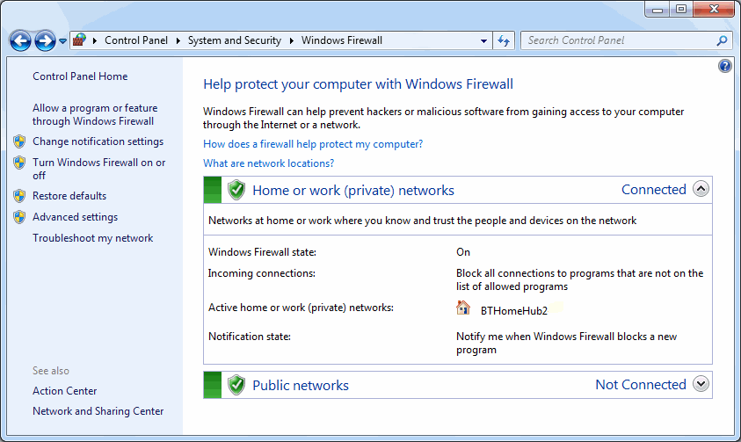
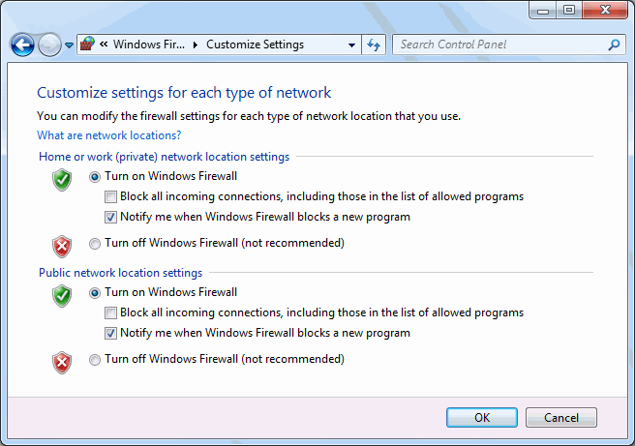
Windows Firewall
Since Windows XP there has been a basic firewall included in Windows. This can be enabled or disabled.
It is intended to prevent malicious connections to your computer.
The examples here are from Windows 7.
There are also many third-party firewalls that aim to control traffic and program activity.
You must have a firewall - at least a basic firewall installed and enabled.

Slide 31
Malware Protection
You also need malware (virus, spy-ware, trojan, etc.) protection
  on-access scan to prevent malware getting into the system in the first place.
  off-line scan ability to run system scans to detect and delete (or quarantine) malware that has got onto the system.
  commercial vendors such as McAfee, Norton (Symantec), Kaspersky and many more. Also Windows Defender.

Slide 32
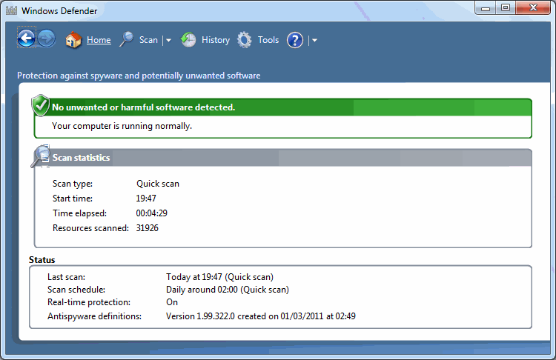
Windows Defender from Microsoft
Windows Defender from Microsoft is intended to give protection against some malicious and unwanted software.
You can set it to perform real-time protection (on-access scan) as well as periodic off-line scanning of your system.
It can usually be installed to run in the same environment as commercial anti-malware software (other anti-virus tools often fight each other).
Microsoft are increasing their provision of security software.
Windows Defender from Microsoft is intended to give protection against some malicious and unwanted software.
You can set it to perform real-time protection (on-access scan) as well as periodic off-line scanning of your system).
It can be installed to run in the same environment as commercial anti-malware software (other anti-virus tools often fight each other).
Microsoft are increasing their provision of security software.

Slide 33
Integrated Packages
Several vendors supply packages integrating many security features:
  malware protection (on-access & scan)
  firewall (incoming and outgoing)
  program control
    Which programs are allowed to access or serve the internet
    Which programs are allowed to interact with other programs
  spam control, anti-phishing strategy
  parental control, privacy (cookie) control.

Slide 34
Windows Vista & 7
Microsoft included extra security features in Windows Vista & Windows 7
  e.g. firewall does more than the XP one does
Security firms still highlight what they see as Vista or 7 vulnerabilities, of course
  Windows offers a very big target for attack
  There will be a continued need for third party security software
    To the delight of everyone and the profit of many.

Slide 35
Get Protected
The previously mentioned vendors all sell products that provide some form of integrated security protection
  McAfee, Norton, Kaspersky and others
  ZoneAlarm from Check Point is another well-known product
Unless your organisation provides your protection, you must equip yourself
  home computers are very vulnerable.

Slide 36
Recommended Reading
“Operating Systems” by William Stallings
(Prentice Hall International Editions)
  Security, p 634 (Ed.6), p 659 (Ed.7).
  Windows Security, pp.697-701 (Ed.6), pp.687-692 (Ed.7).
  Malicious Software, pp.647-663 (Ed.6), pp.639-655 (Ed.7).
  Malware Defense, pp.677-687 (Ed.7).

